Slide 1

Rex int’l logistics
SINCE 1994

Slide 2
Contents
ALL ABOUT “REX LOGISTICS”
CERTIFICATES OF REX
TRACING CARGO WITH REX WEB SERVICE SYSTEM
3PL SERVICE
PARTNERSHIP & EFFECTS
EPILOGUE

Slide 3
Introduction all about rex int’l logistics
REX Int’l ..is a NVOCC, Freight forwarder has IATA and AEO.
Established in 1994,Sep.
All REX Int’l Logistics personnel share a can-do attitude and are motivated by creating logistics solutions that work no matter what the situation.
REX has experienced steady growth and success each year and has firmly established an excellent reputation with the export and import community, and feel that our highest priority relies on our customer satisfaction.

Slide 4
REX will continue to provide high quality service to become best freight forwarder in Korea. We are not only interested in becoming bigger company but good company who has efficiency and responsibility.
REX will challenge everything with our long experience and accumulated skills.
REX will also remain flexible to adapt rapid changes of the world.
REX will be ready to deal with you.

Slide 5
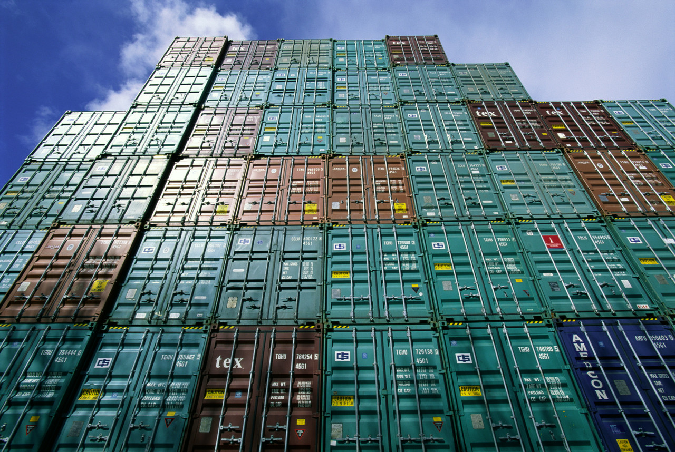
History of REX int’l logistics
HISTORY
1994.09 Establishment
1994.09 Busan branch office/ Incheon Airport office Opened
1994.10 Registration of FIATA
1995.06 Forwarding work Computerized
1999.07 Obtained membership of IATA
1999.10 Obtained CASS membership
2001.06 Tracing system Computerized
2006.03 SLOVAKIA office Opened
2008.06 ISO 9001 certified
2009.02 Opened Busan airport branch office
2011.03 AEO certified
2010.10 Slovakia office merged, holds 20% of the office.

Slide 6
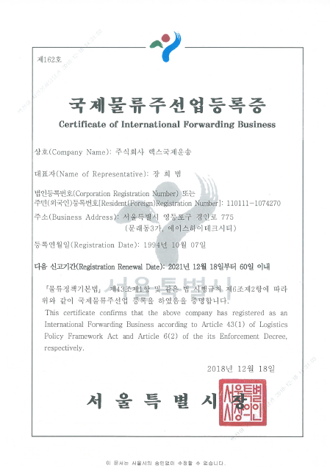
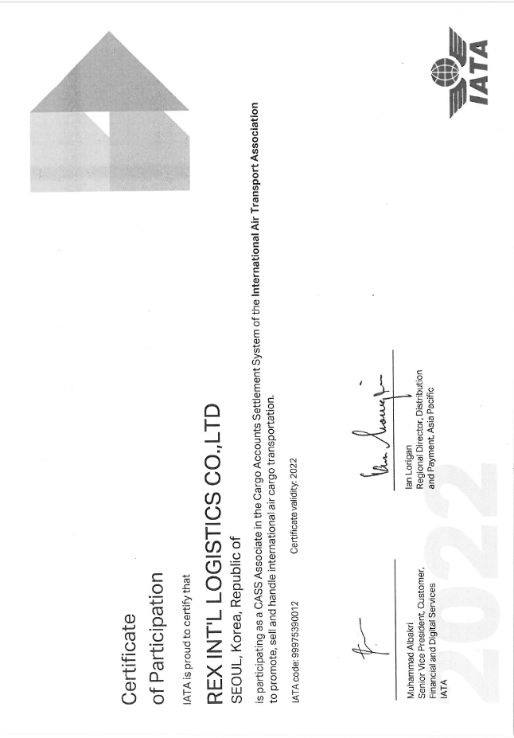


Certificates (global standard)
iata
Fiata

Slide 7
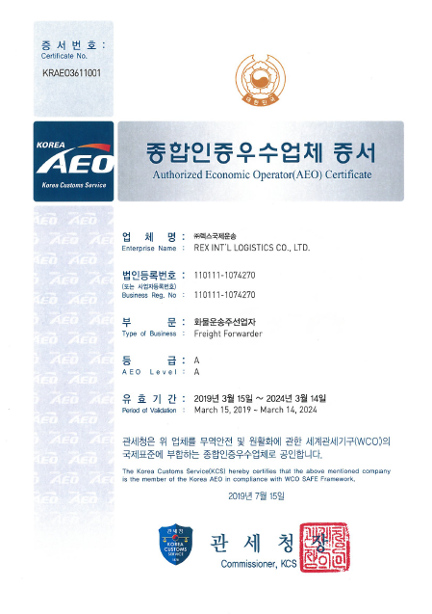
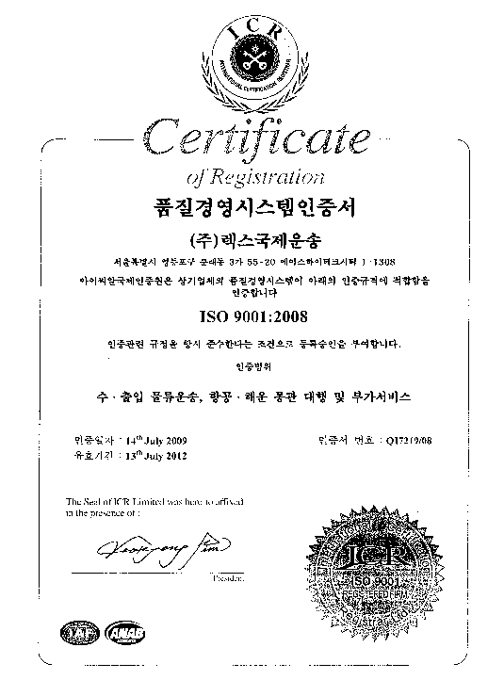


Certificates (global standard)
AEO
ISO 9001

Slide 8
The benefit of aeo
As a certified AEO company REX take less time in process import and export custom clearance. Once you get the certificate of AEO means you have good reliability and will have competitive position in many country. ( Nowadays, there are 38 nations in use of AEO system. ex: US, EU, Canada, China, Japan..)
AEO is certificated by Korean Customs Service.
Recently, many global company require having AEO certification to deal with them.(3M, Bowing, Bayer..etc.)
If you got class in AEO, you will get the maximum benefit of custom clearance service. Less costs, less time.
AEO certification also means, having restrict workplace and classified information to others. Having a good security for facility.
There are more than 3,500 Freight Forwarding Companies in Korea, but only 101 has AEO certificate.(2013.01.01) Which shows it is hard to get this certification.
If you deal with company who has AEO certificate, you will get less custom examination and less time to process.

Slide 9
organization
ACCOUNT
CEO (H.B. JANG)
HEAD OFFICE
INCHEON OFFICE
SALES DEPT
OPERATION
IT DEPT
INBOUND
OUTBOUND

Slide 10
How to contact us
You can contact us anytime we will be waiting for your call.
Please feel free contacting us.
Branch | Telephone | Fax | E.Mail
Head Office Account | +82-2-6309-5200 +82-2-6309-5205 | +82-2-6309-5210 | hbjang@ril.co.kr
Incheon Office | +82-32-744-4280 | +82-32-744-4281 | sinair@nate.com
Web - Site | www.ril.co.kr
Inbound / Outbound | In-bound : reximport@ril.co.kr Out-bound : rexocean@ril.co.kr rexair@ril.co.kr Account : mookza@ril.co.kr Sales Dept : samuel@ril.co.kr

Slide 11
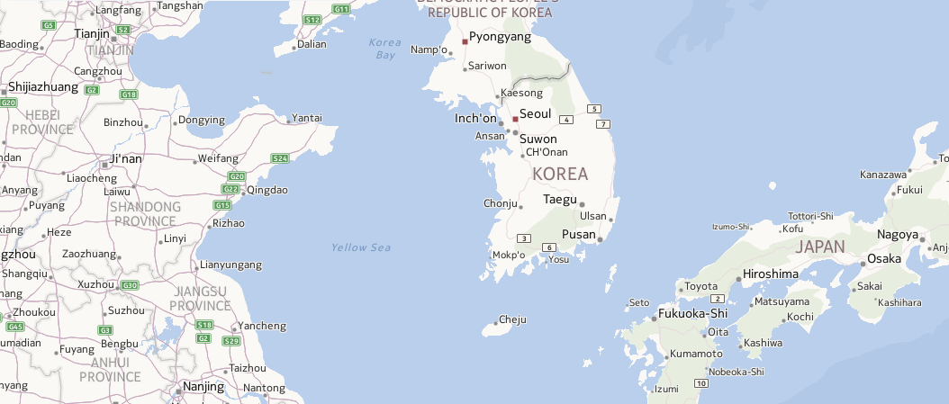
Locations of us
Incheon Office
Seoul, Head Office

Slide 12


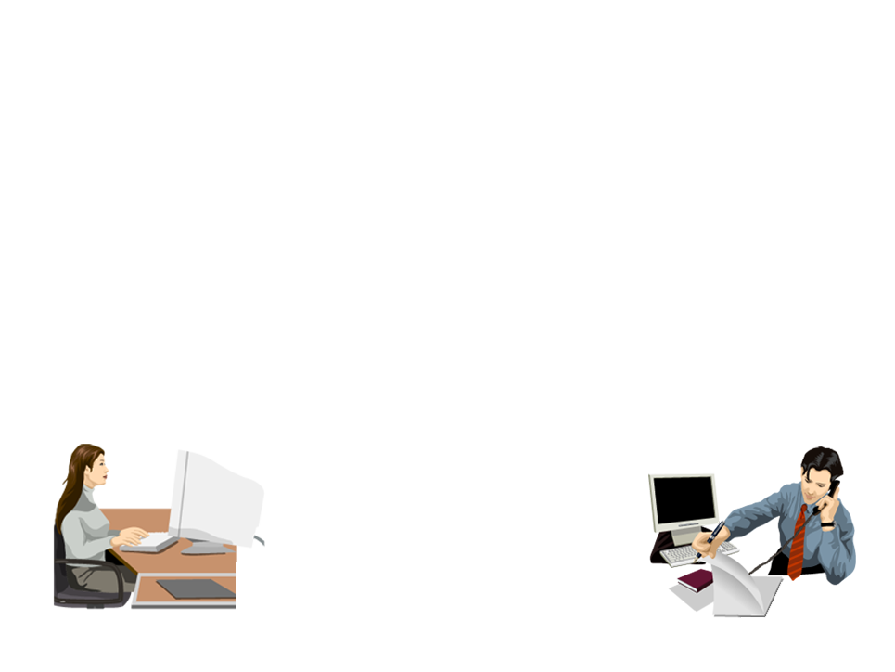








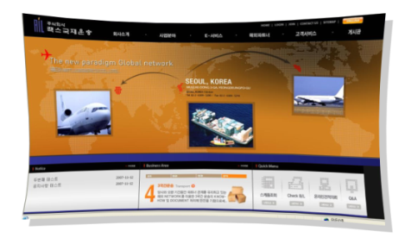




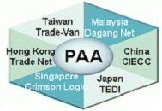










IT network
CUSTOMS

Slide 13
Business scope
REX
[Transportation]
- Air
- Sea
- Trucking
[Custom clearance service]
- Exclusive price for REX
- Fast clearance
- Got many licenced customs agencies
[WareHousing]
- Pick up / Packing
- Consolidation
- Inventory Management
[Computerized service]
- Cargo tracing in real time
- Appropriate Transportation arrange
- Minimized warehouse charge

Slide 14
3PL SERVICE
Like these days commercial depression, many companies are interested in reducing expenses. So, 3PL service can be a solution who wants to reduce expenses. By out sourcing the administration of physical distribution, you can use high qualified distribution service with lower costs and less time.
We are also very interested in 3PL service and willing to deal with those demands if there is. We can also arrange who wants to open 3PL service in Korea.

Slide 15
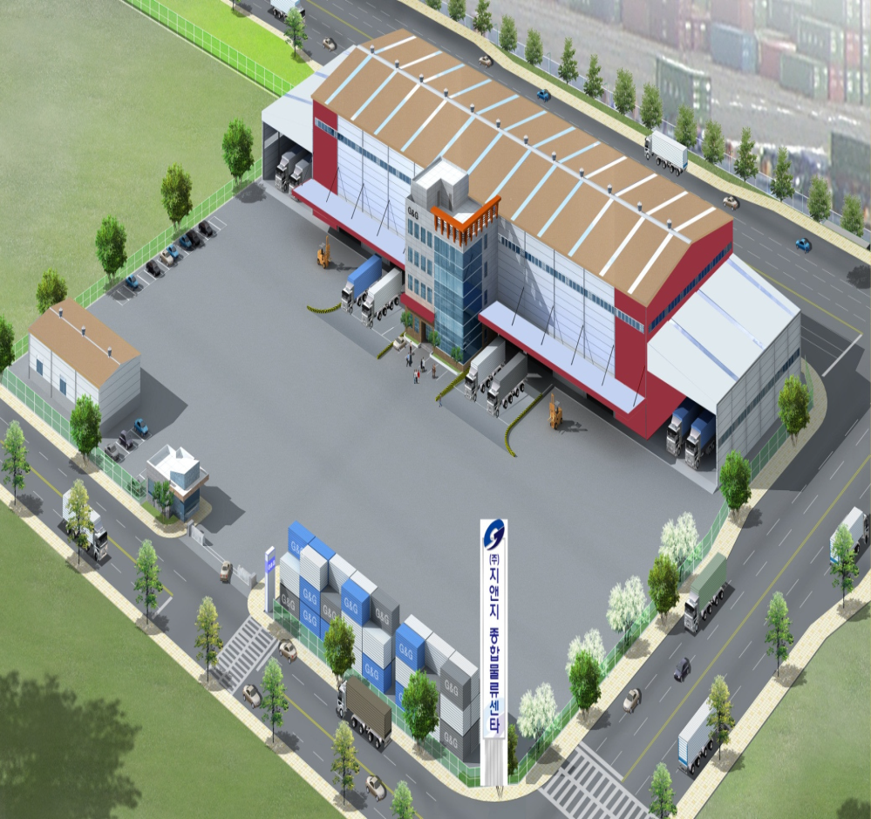
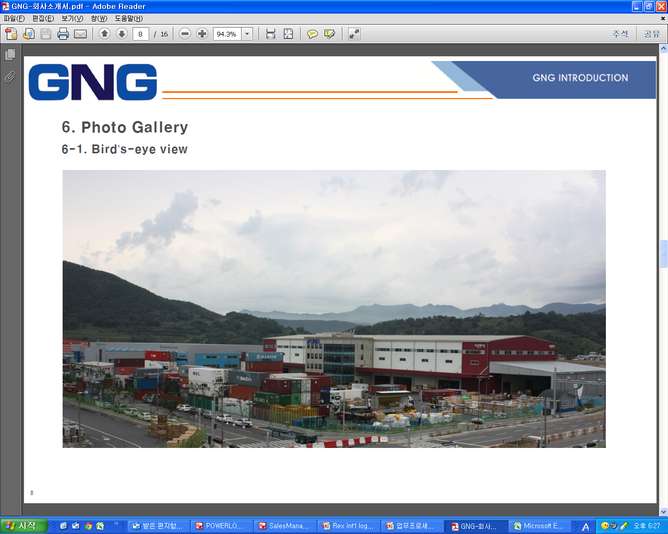
3pl location & facility
CONTRACTED WAREHOUSE ADDRESS : 1323 YONGWON DONG, JINHAE-GU, CHANGWON CITY,
GYEONGSANGNAM-DO, SOUTH KOREA

Slide 16
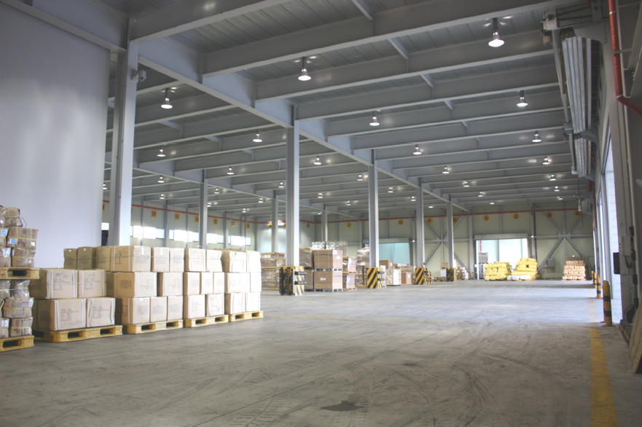
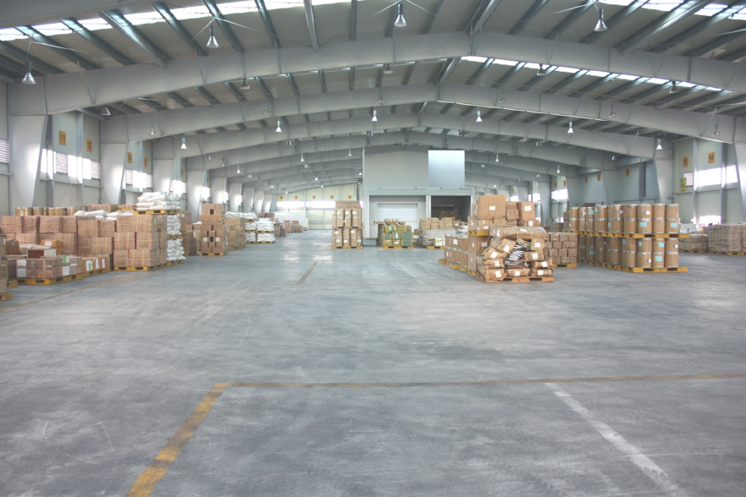
3pl location & facility
1st Floor
2nd Floor

Slide 17
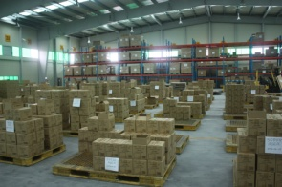
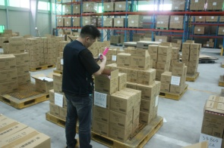
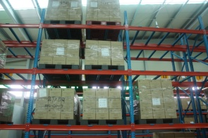
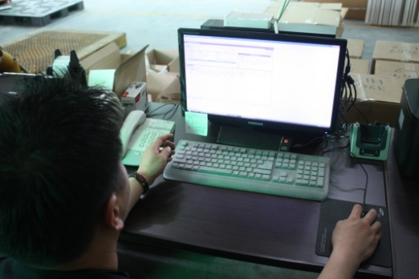
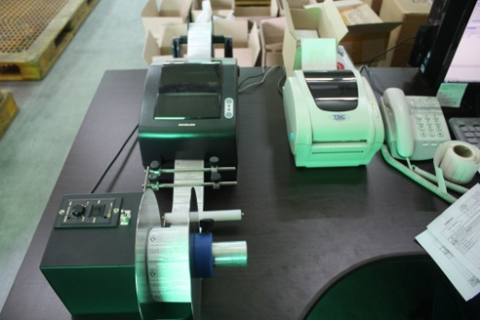
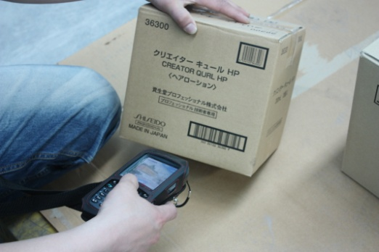
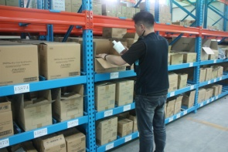
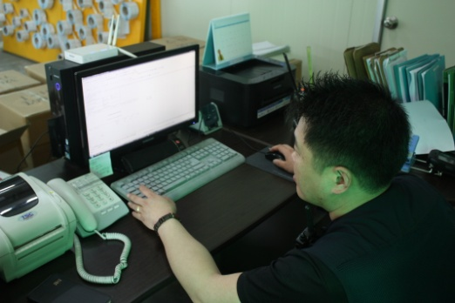
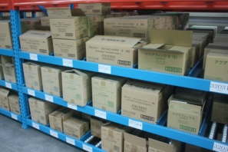
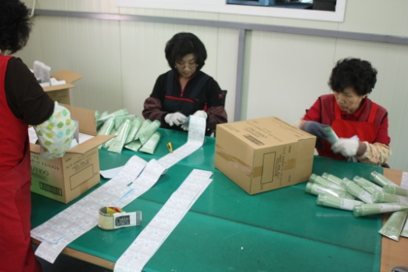
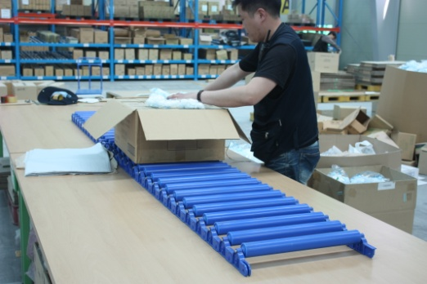
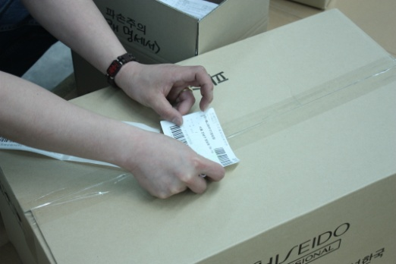
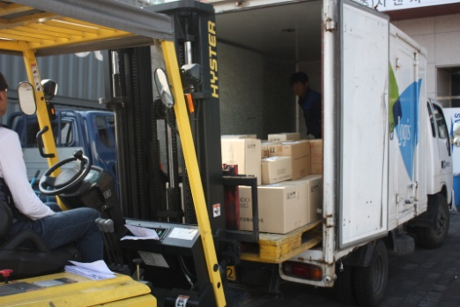
3pl PROCEDURE (EXAMPLE : COSMETIC PRODUCTS)
SORTING
FIRST CHECKING
STORAGE
INPUT LABEL
PRINTING LABEL
PRODUCT CHECKING
PRODUCT SELECTION
TAKING DELIVERY ORDER
STORAGE
TAGGING LABEL
PACKING
SERIAL NUMBER INPUT
PRINTING LABEL
TAGGING LABEL
DELIVERY

Slide 18
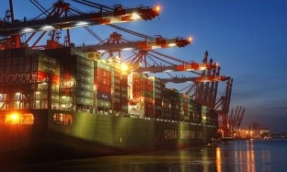
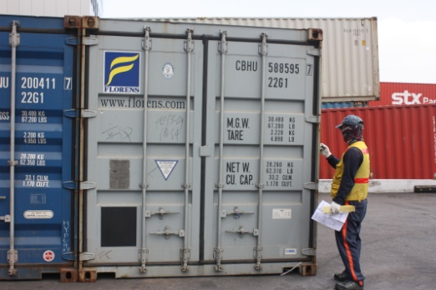
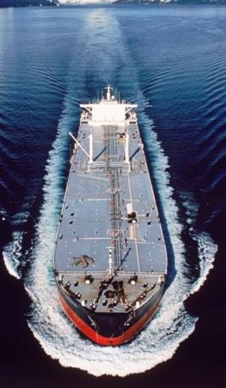
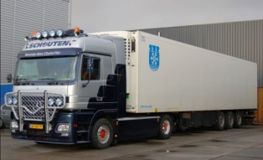
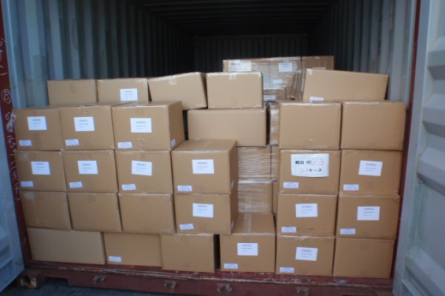
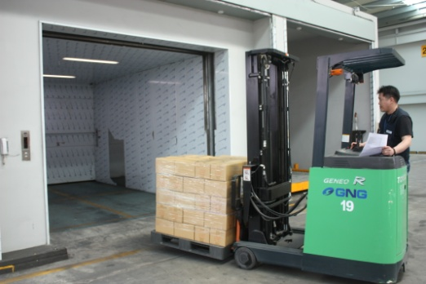
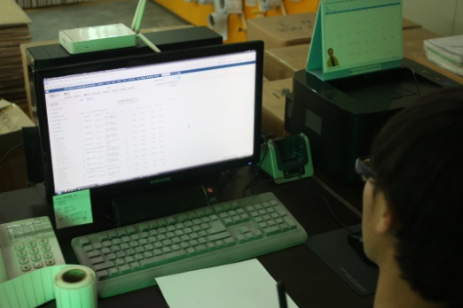
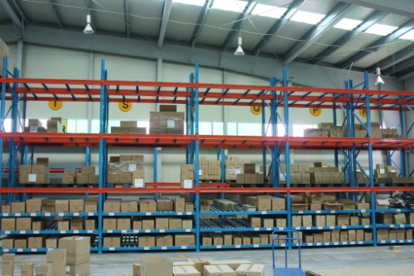
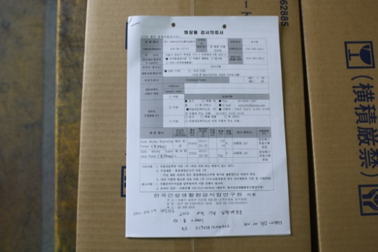
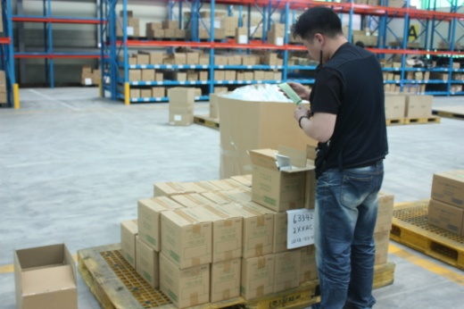
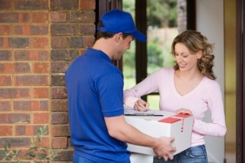
DOCUMENT ACCEPTANCE
UNLOADING
WAREHOUSE ACCEPTANCE
INPUT WAREHOUSE SYSTEM
STOCK INTO WARESHOUSE
OCEAN TRANSPORT
INPUT PROGRAM
DELIVER TO WAREHOUSE
CHECKING GOODS
LABELING
CARGO CHECKING
TAKE DELIVERY ORDER
SORTING GOODS & PLACING
CUSTOMS CLEARANCE & SAMPLE CHECK
CHECKING GOODS
PACKING
FINAL LABELING
TRANSFER
DELIVERY

Slide 19
Partnership
Our partnership mind is based on growing up together.
Since we have same interest and target we guess, it’s not going to be difficult sharing projects as a partnership.
We can also enter to each others business boundary through exchanging business.
We will help you expand business boundary and sharing tactical business plan. So that can lead you to successful cooperation as a Strategic alliance
We do have high level of reliability through partners.
We can help you with long period operation of our company and we also can get help from you.
We develop business by visiting the actual clients for each other under the name of partner.

Slide 20
EXPECTED EFFECTS
- Reliable local partner to handle your cargo.
- You can Expand business boundary with us.
- Having oversea branches without establishment.
- We want to share our know how, vision, our way of business together also ready to learn from partners.
- We want to be a good company has a ability get through all the problems with “can do” attitude.
- We treat your work as ours with cautious care. We’d like to grow up together by helping each others.
- We will make sure you won’t regret becoming our partner.!

Slide 21
Epilogue CEO – mr. jang
Although IT technology has been improved so much, freight forwarding is a human business. It is necessary keeping constant client contact and developing new client.
In the same way, to improve business between partners, needs constant information exchanging and visiting each others for a sales call (if necessary). Also, I believe we need to concentrate our forces depends on regions and character of our clients.
Finally, thanks for the host, let us have an opportunity of REX’s presentation. With this opportunity, we’d like to build a new relationship (based on mature understanding) and hope to be chance of good business from now on.

Slide 22
Thank you!

